Slide 1
Code Reviews
James Walden
Northern Kentucky University

Slide 2
Topics
Types of Reviews
Code Review Process
Checklists
Prioritizing Code to Review

Slide 3
Code Reviews
Inspection of source code by one or more people who aren’t the author of the code.
Goal: Identify defects for later removal.
People: Moderator, reviewers.
Scope: Module or small set of classes.
Time: 1-2 hours; <1kloc

Slide 4
Benefits of Code Reviews
Find defects sooner in the lifecycle.
(IBM finds 82% of defects before testing.)
Find defects with less effort than testing.
(IBM—rev: 3.5 hrs/defect, test: 15-25 hrs/defect.)
Find different defects than testing.
(Can identify design and requirements problems too.)
Educate developers about security bugs.
(Developers frequently make the same mistakes.)

Slide 5
PCI DSS
6.3.7.b Obtain and review policies to confirm that all
custom application code changes for web applications
must be reviewed (using either manual or automated
processes) as follows:
 Code changes are reviewed by individuals other
then the originating code author, and by
individuals who are knowledgeable in code revie
techniques and secure coding practices.
 Code reviews ensure code is developed accordin
to secure coding guidelines such as the Open
Web Security Project Guide (see PCI DSS
Requirement 6.5).
 Appropriate corrections are implemented prior to
release.
 Code review results are reviewed and approved
by management prior to release.

Slide 6
Inspections
Most formal process.
Thorough coverage with separated roles.
Use checklists to focus on specified goals.
Collect metrics to track defects.
Determine whether further inspections of revised software needed at end of meeting.
Extensive documentation of effectiveness.
One study found 16-20 defects/kloc with inspections compared with 3 defects/kloc in informal walkthrough.

Slide 7
Roles in Reviews
Moderator
Manages meeting; follows up on issues.
Reader
Paraphrases code during meeting.
Not the author.
Recorder
Records bugs discovered.
Author
Provides context for code; answers questions.
Makes corrections after code review.

Slide 8
Walkthroughs
Less formal process.
Author leads meeting and describes code.
Focus on author needs, not quality goals.
No checklists used or metrics gathered.
Quality varies widely.
Walkthrough quality depends solely on author.
Useful for educating developers about code, provide high level view of design and defects.

Slide 9
Code Review Process
Planning
Prep
Meeting
Rework
Follow-up
Author
Moderator
Everyone
Everyone
Author
Author
Moderator

Slide 10
Planning
Planning
Prep
Meeting
Rework
Follow-up
Author
Moderator
Everyone
Everyone
Author
Author
Moderator
Author initiates Planning once code ready.
A Moderator is assigned to inspection.
Author and Moderator assemble inspection pkg.
Moderator identifies other participants.
Notes:
Code being ready means that it compiles without warnings and passes all unit tests.

Slide 11
Preparation
Planning
Prep
Meeting
Rework
Follow-up
Author
Moderator
Everyone
Everyone
Author
Author
Moderator
Reviewers examine inspection package.
Reviewers use checklists and analysis tools.
Reviewers mark bugs found.

Slide 12
Meeting
Planning
Prep
Meeting
Rework
Follow-up
Author
Moderator
Everyone
Everyone
Author
Author
Moderator
Reader describes code in own words.
Reviewers comment and ask questions.
Recorder notes all potential bugs, suggestions.
Team appraises code at meeting conclusion.

Slide 13
Rework
Planning
Prep
Meeting
Rework
Follow-up
Author
Moderator
Everyone
Everyone
Author
Author
Moderator
Author addresses issues recorded at meeting.

Slide 14
Follow-up
Planning
Prep
Meeting
Rework
Follow-up
Author
Moderator
Everyone
Everyone
Author
Author
Moderator
Moderator meets with Author about rework.
Moderator verifies all changes made correctly.
Author checks in corrected code.

Slide 15
Formality Spectrum
Review | Planning | Prep | Meeting | Rework | Followup
Inspection | Yes | Yes | Yes | Yes | Yes
Team Review | Yes | Yes | Yes | Yes | No
Walkthrough | Yes | No | Yes | Yes | No
Pair Programming | Yes | No | Con-tinuous | Yes | Yes
Peer Deskcheck | No | Yes | Possibly | Yes | No
Ad Hoc Review | No | No | Yes | Yes | No
Notes:
Table 3-1 from page 33 of Peer Reviews in Software by Karl Wiegers

Slide 16
Code Review Tips
Know your limits.
Typical review speed is 150-200 lines/hour.
Limit meeting length to 1-2 hours.
Know what bugs to look for.
Checklists
Static analysis tools
Use tools.
Simple tools: grep, findstr
Code viewers
Static analysis tools
Require preparation before the meeting.

Slide 17
Checklists
Security reviews should include checklists of
common problems, including:
SQL injection
Cross-site scripting
Input validation bugs
Checking return values
Resource name canonicalization
Race conditions

Slide 18
Code Review Problems
Requires substantial expertise in area of programming and security to be effective.
Human readers are fallible and will miss mistakes.
Code reviews are slow. Unreviewed legacy code will take time to review.

Slide 19
Prioritizing Code
If you can’t review everything, review
Code that runs with privileged mode.
Code that listens on globally accessible sockets.
Code that is accessible w/o authentication.
Code with a history of vulnerabilities.
Code that handles sensitive data.
Complex code.
Code that changes frequently.

Slide 20
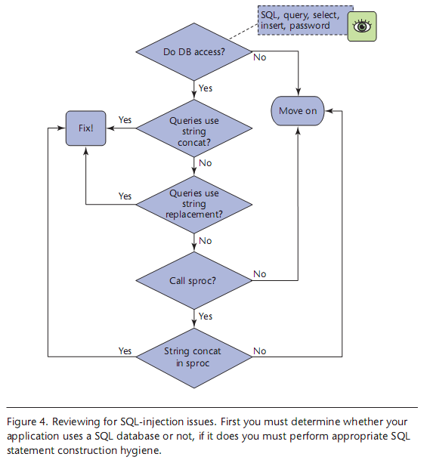
Reviewing for SQL Injection
Notes:
Diagram from Michael Howard, “A Process for Performing Security Code Reviews.” IEEE Security & Privacy, July 2006.

Slide 21
Ex: Zune infinite loop on 12/31/08
year = 1980; while (days > 365) { if (IsLeapYear(year)) { if (days > 366) { days -= 366; year += 1; } } else { days -= 365; year += 1; } }
Notes:
See http://www.freedom-to-tinker.com/blog/felten/debugging-zune-blackout for full details on the bug.

Slide 22
Key Points
Roles
Moderator
Reader
Recorder
Author
Process
Planning
Preparation
Meeting
Re-work
Followup

Slide 23
References
Brian Chess and Jacob West, Secure Programming with Static Analysis, Addison-Wesley, 2007.
Michael Howard, “A Process for Performing Security Code Reviews.” IEEE Security & Privacy, July 2006.
Eoin Keary et. al., OWASP Code Review Guide 1.1, http://www.owasp.org/index.php/Category:OWASP_Code_Review_Project, 2008.
Steve McConnell, Code Complete, 2/e, Microsoft Press, 2004.
Gary McGraw, Software Security, Addison-Wesley, 2006.
PCI Security Standards Council, PCI DSS Requirements and Security Assessment Procedures, v1.2, 2008.
Karl Wiegers, Peer Reviews in Software, Addison-Wesley, 2002.

